Slide 1
Economics 144 Economic Forecasting
Lecture 8
Characterizing Cycles
Autoregressive Models
Dr. Randall R. Rojas

Slide 2
Today’s Class
Cycles
Autoregressive (AR) Models
The AR(1) Process
The AR(2) Process
The AR(p) Process
Chain Rule for Forecasting
R Example

Slide 3
Cycles 1 of 3
Def: Cycle = Time series pattern of periodic fluctuations.
Deterministic: Common in engineering, physical sciences, etc. Example: Y_{t} = 2 cos(0.5t+0.8)+ε_{t}
Stochastic: Common in economics, business, etc. Example: Y_{t} = 0.5Y_{t-1} + 0.3Y_{t-2} +ε_{t}

Slide 4
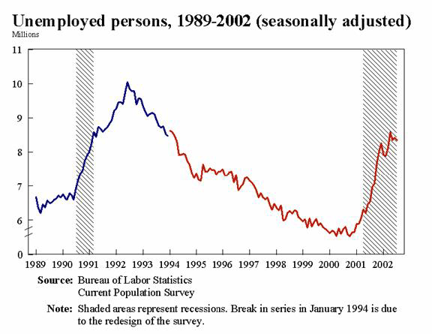
Cycles 2 of 3
Deterministic
Y_{t} = 2 cos(0.5t+0.8)+ε_{t}
Stochastic
Y_{t} = 0.5Y_{t-1} + 0.3Y_{t-2} +ε_{t}

Slide 5
Cycles 3 of 3
B
A
D
C

Slide 6

Autoregressive Models
Def: AR(p) = Autoregressive process of order p≥0: Y_{t} = c +ϕ₁ Y_{t-1} + ϕ₂ Y_{t-2} + …+ϕ_{q} Y_{t-p} +ε_{t}, where , and ϕ = persistence parameter.
Examples:
AR(1): Y_{t} = c +ϕ₁ Y_{t-1} + ε_{t}
AR(2): Y_{t} = c +ϕ₁ Y_{t-1} + ϕ₂Y_{t-2}+ ε_{t}
AR(6): Y_{t} = c +ϕ₆Y_{t-6}+ ε_{t}

Slide 7
Autoregressive Models
For every AR(p) process, we need to address the following 3 questions:
What does a time series of an AR process look like?
What do the corresponding ACFs and PACFs look like?
What is the optimal forecast?

Slide 8
Autoregressive Models Example: AR(1) Process
(1) What does a time series of an AR process look like?
Consider the following AR(1) process:
Y_{t} = c +ϕ Y_{t-1} + ε_{t}
We can plot this process for c =1, and different values of ϕ, e.g., for ϕ=0.4, ϕ=0.7, ϕ=0.95, and ϕ=1.
We can show that E(Y_{t})=c+ϕμ, and σ²(Y_{t}) = σ²_{ε} / (1-ϕ²)
Note: Since E(Y_{t})=μ → μ =c+ϕμ → μ = c/(1-ϕ )

Slide 9
AR(1): Y_{t} = c +ϕY_{t-1} + ε_{t}
ϕ=0.4
ϕ=0.7
ϕ=0.95
ϕ=1

Slide 10
Autoregressive Models Example: AR(1) Process
(2) What do the corresponding ACFs and PACFs look like?
ACF:
We would expect to see that ρ₁ = p₁ = ϕ, and all others decay to zero according to ρ_{k}= ϕ^{k}.
PACF:
We would expect to see only 1 spike different from zero, i.e., p₁ = ϕ, and all others equal to zero (p_{k}=0, k>1).

Slide 11
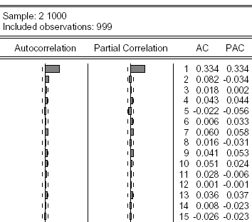
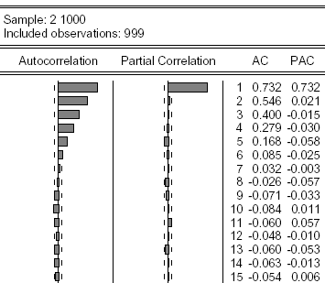
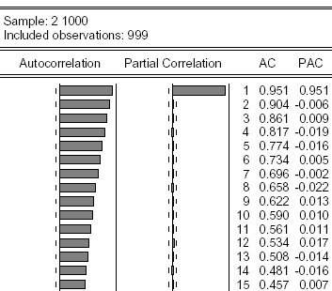

Autocorrelation Functions of Simulated AR(1) Processes
Small persistence
→faster decay to 0
Y_{t} = c +ϕY_{t-1} + ε_{t}
Large persistence
→slower decay to 0
For all three cases

Slide 12
Autoregressive Models Example: AR(1) Process
A useful Property for AR Processes:
A necessary and sufficient condition for an AR(1) process Y_{t} = c +ϕY_{t-1} + ε_{t} to be covariance stationary is that |ϕ|<1.

Slide 13
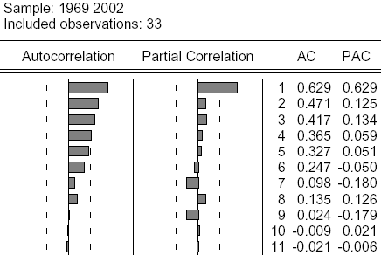

Autoregressive Models Example: AR(1) Process
Q: Does this series look like an AR(1) process?
A: Yes, since ρ₁ = p₁ = ϕ and ρ_{k} →0 for k>1.

Slide 14
Autoregressive Models Forecasting in an AR(1) Process
Consider first the 1-step-ahead forecast, h = 1:
AR(1): Y_{t} = c +ϕY_{t-1} + ε_{t} → Y_{t+1} = c +ϕY_{t} + ε_{t+1}
Optimal Point Forecast: f_{t,1} = E(Y_{t+1}|I_{t}) = c +ϕY_{t}
One-period-ahead Forecast Error: e_{t,1} = Y_{t+1} - f_{t,1}= ε_{t+1}
Uncertainty of the Forecast: σ²_{t+1|t} = var(Y_{t+1}|I_{t}) = σ²_{ε}
Density Forecast: f(Y_{t+1}|I_{t}) ~ N(c +ϕY_{t} , σ²_{ε} )
Note: We can compute the confidence intervals from the density forecast.
Please go over the steps for h=1 and h=2 (Section 7.2ª)

Slide 15
Autoregressive Models Forecasting in an AR(1) Process
Consider the k-step-ahead forecast, h = k for the
AR(1): Y_{t} = c +ϕY_{t-1} + ε_{t} process:
Optimal Point Forecast: f_{t,k} = E(Y_{t+k}|I_{t}) = c(1+ϕ+…+ϕ^{k-1}) +ϕ^{k}Y_{t}
k-period-ahead Forecast Error:
e_{t,k} = Y_{t+k} – f_{t,k}=ε_{t+k}+ ϕε_{t+k-1}+…+ ϕ^{k-1}ε_{t+1}
Uncertainty of the Forecast:
σ²_{t+k|t} = var(Y_{t+k}|I_{t}) = σ²_{ε}(1+ϕ²+ϕ⁴+…+ϕ^{2(k-1)})
Density Forecast: f(Y_{t+k}|I_{t}) ~ N(μ_{t+k|t} , σ²_{t+k|t} )
Note: We can compute the confidence intervals from the density forecast.

Slide 16
Autoregressive Models Forecasting in an AR(1) Process
Recall that for covariance-stationary processes, |ϕ|<1 and ϕ^{k} →0 for large values of k (k→∞). Therefore, the optimal forecast does not depend on the information set, and thus has a ‘short-term memory’.
f_{t,k} = c(1+ϕ+ϕ²+…) = c/(1-ϕ)
σ²_{t+1|t} = σ²_{ε}(1+ϕ²+ϕ⁴+…) = = σ²_{ε} /(1-ϕ²)

Slide 17

Autoregressive Models Example: AR(2) Process
Example: Y_{t} = c +ϕ₁ Y_{t-1} + ϕ₂ Y_{t-2} +ε_{t}
A useful Property for an AR(2) Process:
The necessary conditions for an AR(2) process to be covariance stationary are that -1<ϕ₂<1 and -2<ϕ₁<2,
and the sufficient conditions are that ϕ₁+ϕ₂<1 and ϕ₂-ϕ₁<1.
Note: For an AR(2) the respective unconditional mean is given by:

Slide 18
Autoregressive Models Example: AR(2) Process
Q: Is this process stationary?
A: No since ϕ₁+ϕ₂=1
Y_{t} = 1 +0.5Y_{t-1} +0.5Y_{t-2} +ε_{t}

Slide 19
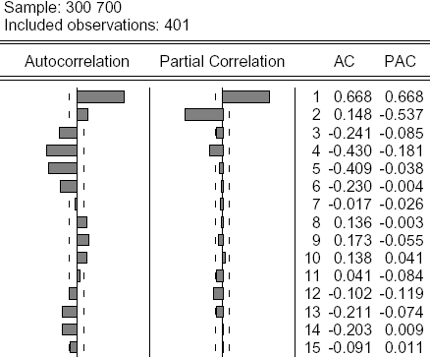
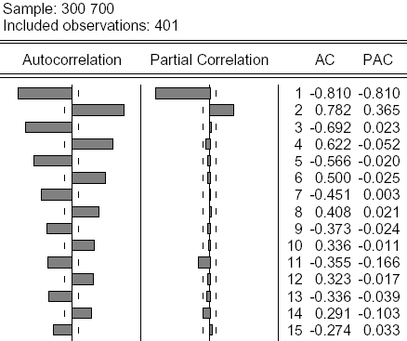
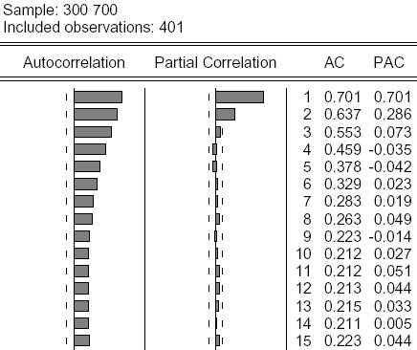
Autoregressive Models Example: AR(2) Process
All three AR(2) Processes have in common:
ρ₁ = p_{1,} p₂ = ϕ₂, and p₁≠0 and p₂≠0, all other p_{k} =0 (k>2)

Slide 20
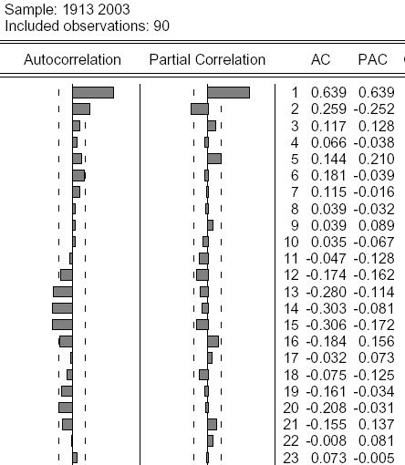
Autoregressive Models Example: AR(2) Process
1913-2003 Inflation Rate
Q: What model would you suggest?
A: An AR(2) with ϕ = -0.25

Slide 21
Multistep Forecast of the U.S. Inflation Rate

Slide 22
Autoregressive Models Example: AR(2) Process

Slide 23
Autoregressive Models AR(P) Process
In general, for an AR(p) process:
Y_{t} = c +ϕ₁Y_{t-1} +ϕ₂Y_{t-1} +… +ϕ_{p}Y_{t-p}+ ε_{t}
We can show that
ρ₁ = p_{1,}
The speed of the ACF’s decay depends on the persistence of ϕ₁+ϕ₂+… +ϕ_{p}
p₁≠0, p₂≠0, …p_{p}≠0, and p_{p}=0 for k>p

Slide 24
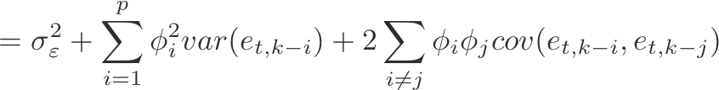
Autoregressive Models Forecasting in an AR(p) Process
Consider the k-step-ahead forecast, h = k for the AR(p): Y_{t} = c +ϕ₁Y_{t-1} +ϕ₂Y_{t-2} +… +ϕ_{p}Y_{t-p}+ ε_{t} process:
Optimal Point Forecast:
f_{t,k} = E(Y_{t+k}|I_{t}) = c+ϕ₁f_{t,k-1}+…+ϕ_{p}f_{t,k-p}
k-period-ahead Forecast Error:
e_{t,k} = Y_{t+k} – f_{t,k}=ε_{t+k}+ ϕ₁e_{t,k-1}+…+ ϕ_{p}e_{t,k-p}
Uncertainty of the Forecast:
σ²_{t+1|t}
Density Forecast: f(Y_{t+k}|I_{t}) ~ N(μ_{t+k|t} , σ²_{t+k|t} )

Slide 25
Autoregressive Models Forecasting in an AR(p) Process
Chain Rule for Forecasting
Y_{t} = c +ϕ₁Y_{t-1} +ϕ₂Y_{t-2} +… +ϕ_{p}Y_{t-p}+ ε_{t}
Step1 (change t→t+1): Compute f_{t,1} = Y_{t+1}
f_{t,1} = c +ϕ₁Y_{t} +ϕ₂Y_{t-1} +… +ϕ_{p}Y_{t+1-p}
Step2 (repeat Step 1): Compute f_{t,2}
f_{t,2} = c +ϕ₁Y_{t+1} +ϕ₂Y_{t} +… +ϕ_{p}Y_{t+2-p}
= c + f_{t,1} + ϕ₂Y_{t} +… +ϕ_{p}Y_{t+2-p}
…
f_{t,k} = c+ f_{t,k-1} + ϕ₂ f_{t,k-2} +… +ϕ_{p} f_{t,k-p}

Slide 26
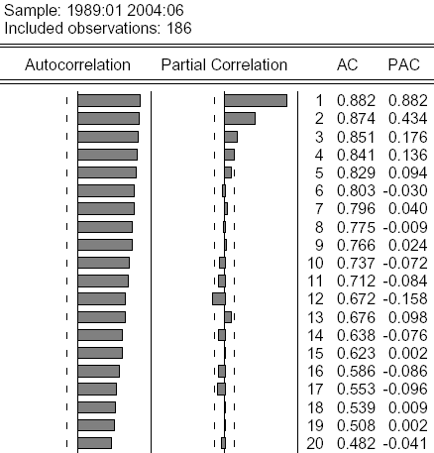
Moving Average Models Example: AR(p) Process
Q: What type of a process is this?
AR(4)
In general, for any AR(p) process, p_{k} = 0 for any k>p.

Slide 27
For Next Class
Readings about today’s class:
Chapter 7ª, 8^{b}
Review Exercises / Problems:
Chapter 8^{b}: 1, 2
Chapter 8^{b}: 2, 3, 4, 9
Readings for next class:
Chapter 7ª (Section 7.3), Chapter 9^{b}

